Slide 1

CS851 - Network Security
DEPARTMENT OF COMPUTER SCIENCE AND ENGINEERING
NATIONAL INSTITUTE OF TECHNOLOGY KARNATAKA
Academic Year : 2021-2022
Course Guide
Dr. M.P. Singh

Slide 2
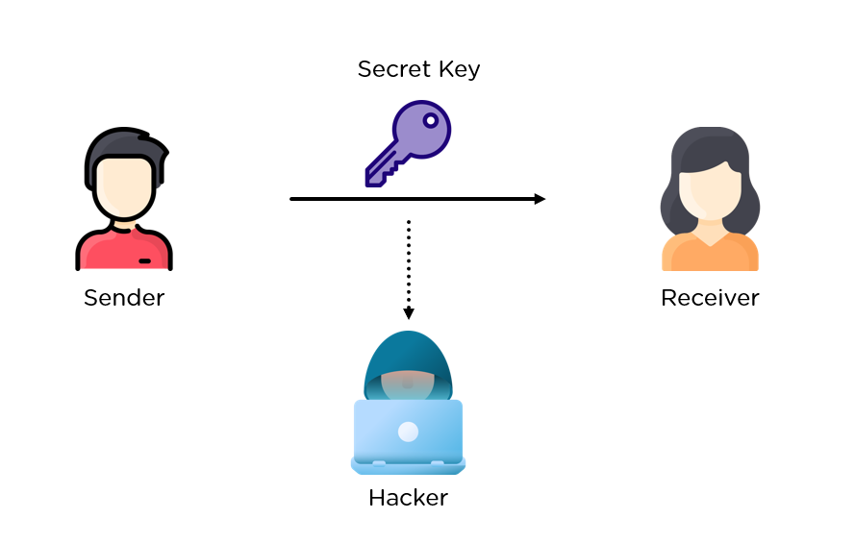
CS851 - Network Security
Secure File Transfer using Diffie- Hellman & 3DES
Ankit Srivastava
(212IS003)

Slide 3
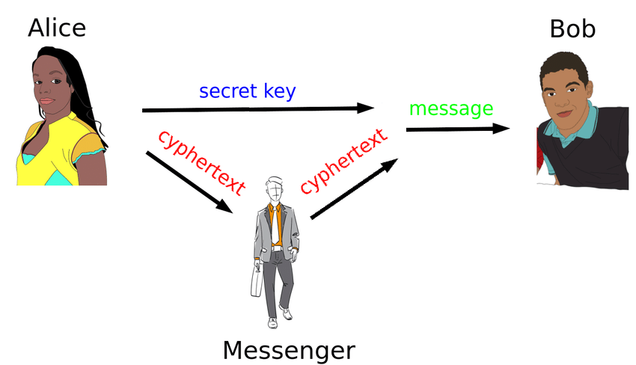
INTRODUCTION
Rising number of assaults and threats in today's world.
Crime rates advances with technology.
Data protection has become one of the most important requirements.
Symmetric encryption techniques

Slide 4
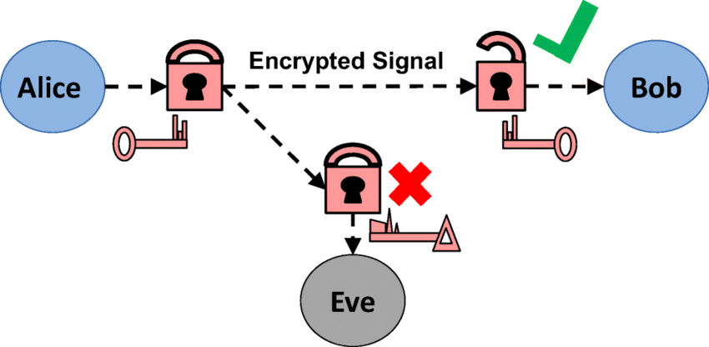
PROBLEM STATEMENT
(Impact of Data Breaches)
Data breaches can bring us to our knees both financially and psychologically
Data is quite likely that it can be sniffed if sent without proper packaging

Slide 5

MOTIVATION & OBJECTIVE
(Secure File Transfer using Diffie- Hellman & 3DES)
Build a secure pipeline for data transmission so that attackers don’t get easy access into his data flow penal
Secure data from dangers such as accidental or intentional data loss, destruction, or abuse

Slide 6
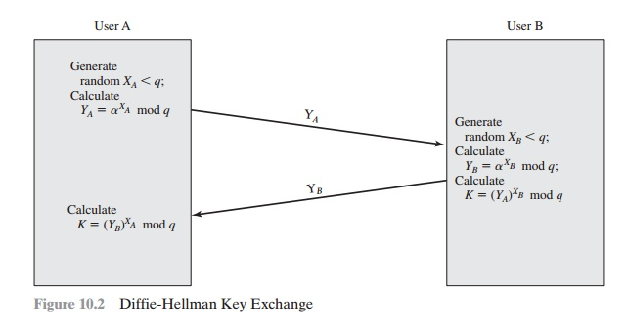
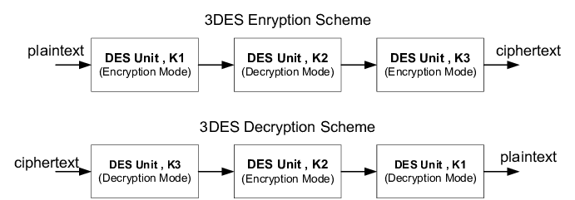
PROPOSED SOLUTION
(Secure File Transfer using Diffie- Hellman & 3DES)
Integrate Diffie-Helman Key Exchange with triple Decryption to make a secure channel of data flow.

Slide 7
SEQUENCE OF EVENT TO RUN
(Secure File Transfer using Diffie- Hellman & 3DES)
Server Side Setup
Open server folder in Linux Terminal
Start the server
Wait for the client
File Transferred Successfully
Client Side Setup
Open client folder in Linux Terminal
Start the client via IPv4 loopback address
(127.0.0.1)
Press 1 to request a file
File Received Successfully

Slide 8
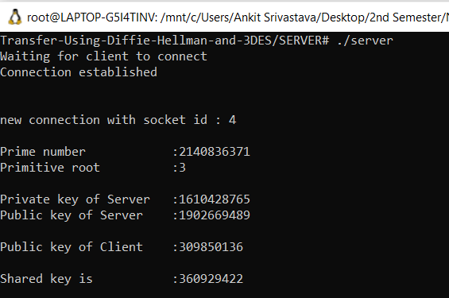
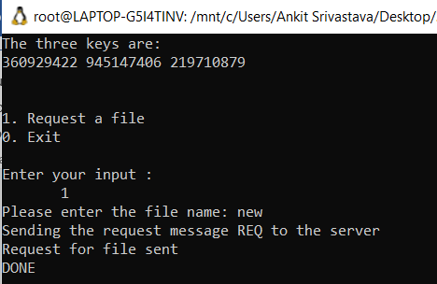
EXPERIMENTAL RESULT
Server Side
Client Side

Slide 9
TOOLS, LANGUAGES & PACKAGES USED
TOOLS
VS CODE : Visual Studio Code is a streamlined code editor with support for development operations like debugging, task running, and version control.
LINUX TERMINAL : A text-based interface used to control a Linux computer. It's just one of the many tools provided to Linux users for accomplishing any given task, but it's widely considered the most efficient method available.
PROGRAMMING LANGUAGE
CPP : C++ is a powerful general-purpose programming language. It can be used to develop operating systems, browsers, games, and so on.

Slide 10
THANK YOU

